Slide 1
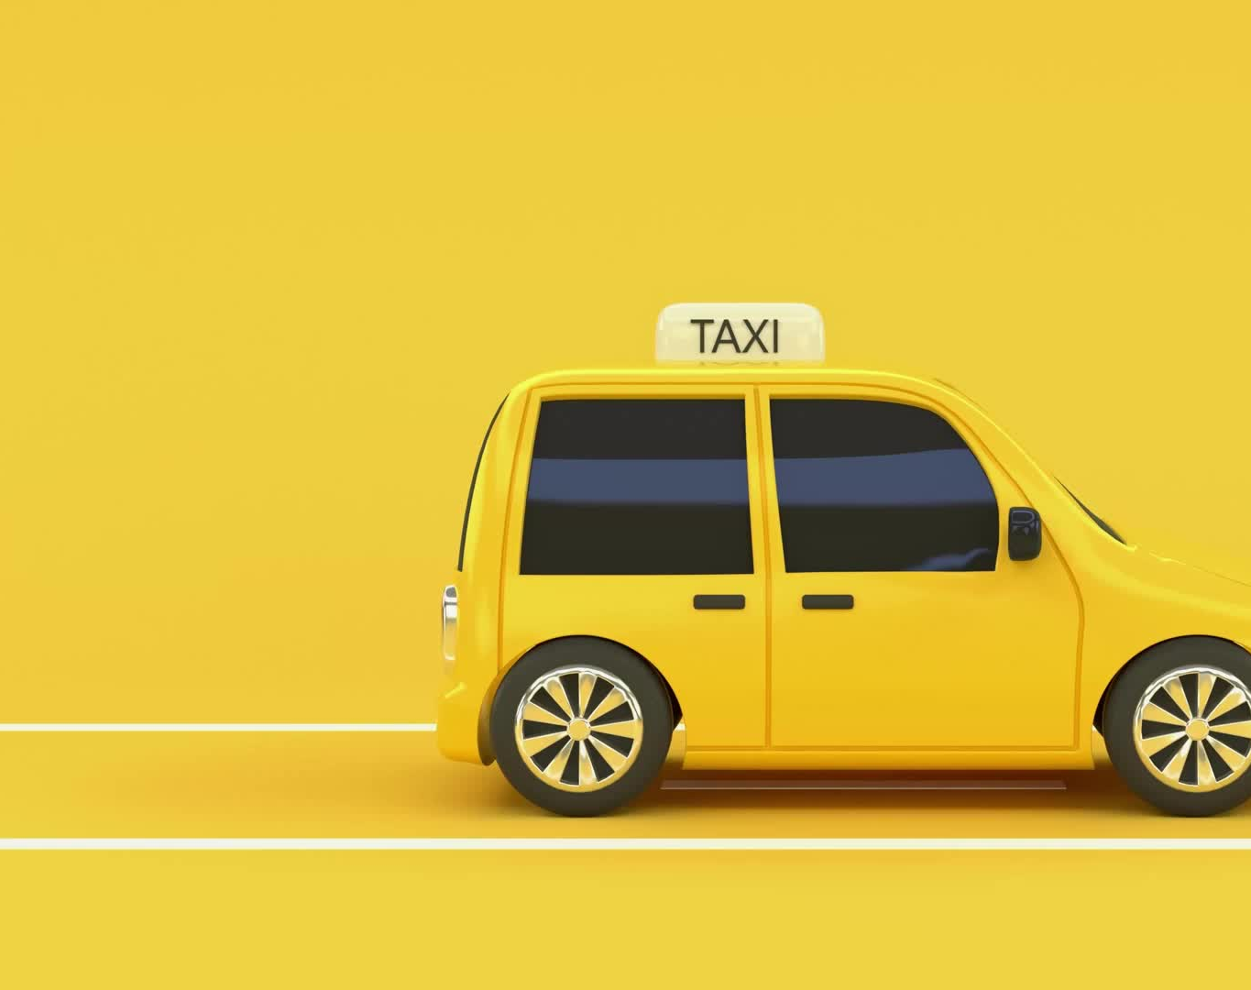
Taxi Trip Duration Analysis

Slide 2
Group Member Information
Kishor Kumar Andekar kxa47130@ucmo.edu
Sai Preetham Nagaswaram sxn33500@ucmo.edu
Pondugula Niteesh Kumar nxp32580@ucmo.edu
Rohith Reddy Pinninti rxp93930@ucmo.edu

Slide 3
Roles, Responsibilities and Contributions
Kishor Kumar Andekar:
Data collection and preprocessing
Exploratory data analysis
Model development and training
Sai Preetham Nagaswaram:
Literature review and related work
Feature engineering and selection
Model evaluation and validation
Pondugula Niteesh Kumar:
Problem formulation and motivation
Design of the deep learning architecture
Integration of advanced techniques (Dropout, BatchNormalization)
Rohith Reddy Pinninti:
Visualization of results and insights
Comparative analysis with baseline models
Documentation and presentation

Slide 4

Motivation
Accurate taxi trip duration prediction is crucial for:
Optimizing taxi operations and dispatch systems
Enhancing passenger satisfaction with reliable estimates
Supporting urban planning and traffic management decisions
Existing models struggle with the complexity and dynamicity of urban environments
Deep learning offers a promising approach to capture intricate patterns and dependencies in taxi trip data

Slide 5
Objectives
Develop a deep learning model to accurately predict taxi trip durations in urban settings
Incorporate advanced techniques like Dropout, BatchNormalization, and the Adam Optimizer to improve model performance and generalization
Utilize comprehensive taxi trip data, including spatiotemporal features, to capture the complex dynamics of urban transportation
Provide insights to support operational efficiency, service quality, and urban planning

Slide 6
Related Work
Statistical models and basic machine learning approaches have been used for taxi trip duration prediction [1]
Deep learning models, such as LSTMs and CNNs, have shown promise in capturing temporal and spatial dependencies [2][3][23]
Integration of real-time data, such as traffic conditions and weather, has improved prediction accuracy [12][18]
Graph Convolutional Networks (GCNs) have been employed to model road network topology and predict taxi demand [10][16]
Multitask learning approaches have been explored to leverage the relationships between related prediction tasks [9][17]

Slide 7

Problem Statement
Predicting taxi trip durations in urban environments is challenging due to:
Dynamic traffic conditions influenced by time, weather, events, and incidents
Complex spatial dependencies and urban infrastructure
High dimensionality and heterogeneity of relevant data sources
Existing models often struggle to capture these complexities and adapt to changing conditions, leading to suboptimal predictions and operational inefficiencies

Slide 8
Proposed Solution
Develop
Develop a deep learning model based on Sequential Neural Networks and Dense Layers
Preprocess the data by cleaning, transforming, and engineering relevant features
Temporal features: time of day, day of week, holiday indicators
Spatial features: pickup and dropoff locations, Haversine distances
Contextual features: passenger count, weather conditions
Incorporate
Incorporate advanced techniques to improve model performance and generalization
Dropout regularization to prevent overfitting
BatchNormalization for faster and more stable training
Adam Optimizer for efficient optimization and convergence
Employ
Employ a robust training and validation strategy
Split the data into training, validation, and testing sets
Use EarlyStopping and ModelCheckpoints to prevent overfitting and save the best model
Perform hyperparameter tuning using techniques like grid search and random search

Slide 9
Results/Simulations
Conducted extensive data analysis and visualization
Geospatial analysis of pickup and dropoff locations
Distribution of trip distances, durations, and fares
Relationship between passenger count and trip characteristics
Evaluated the model using various performance metrics
Mean Squared Error (MSE) and Root Mean Squared Error (RMSE)
Mean Absolute Error (MAE) and R-squared (R²) score
Cross-validation techniques to assess model robustness
Compared the proposed model with baseline models
Linear Regression, Decision Trees, and Ensemble methods
Demonstrated superior performance of the deep learning approach
Achieved promising results on the validation set
MSE: 138385.4677
RMSE: 372.002 (in seconds)
Identified areas for further improvement and refinement
Incorporation of additional data sources and real-time information
Exploration of more advanced architectures and techniques

Slide 10
References
Paper (Year) | Author(s) | Contribution
New York City Taxi Trip Duration Prediction Using Machine Learning (2023) | N. R K, J. K, A. Joseph, K. Sakthivel, S. S. Anandharajan | Utilized machine learning to predict taxi trip durations in New York City, aiming to enhance route planning and efficiency.
Development of predictive modeling and deep learning classification of taxi trip tolls (2022) | S. Al-Shoukry, B. J. M. Jawad, Z. B. Musa, A. H. Sabry | Developed predictive models and deep learning algorithms for classifying taxi trip tolls, improving fare estimation.
MLRNN: Taxi Demand Prediction Based on Multi-Level Deep Learning and Regional Heterogeneity Analysis (2022) | C. Zhang, F. Zhu, Y. Lv, P. Ye, F. -Y. Wang | Introduced a multi-level deep learning approach to predict taxi demand, taking into account regional variations.
A taxi demand prediction model based on spectral domain graph convolution (2023) | X. Xue, C. Zhou, X. Zhang, J. Guo | Employed spectral domain graph convolution for taxi demand prediction, enhancing prediction accuracy.
Block Popularity Prediction for Multimedia Storage Systems Using Spatial-Temporal-Sequential Neural Networks (2021) | Y. Cheng et al. | Utilized spatial-temporal-sequential neural networks to predict block popularity in multimedia storage systems, contributing indirectly to traffic data analysis.
A Deep Learning Approach to Forecasting Short-Term Taxi Demands (2022) | U. Sahin | Applied deep learning to forecast short-term taxi demands, supporting dynamic dispatching and resource allocation.
Prediction of Taxi Destinations Using a Novel Data Embedding Method and Ensemble Learning (2020) | X. Zhang, Z. Zhao, Y. Zheng, J. Li | Developed a method combining data embedding and ensemble learning to predict taxi destinations, improving service efficiency.
DeepCorNet: An Efficient Taxi-Hailing Prediction Model (2020) | F. Mao, Z. Li, K. Zhang | Created DeepCorNet to predict taxi-hailing demands, optimizing the allocation of taxis across urban areas.
Forecasting of origin-to-destination requests for taxis using DNN algorithm with NYU database (2023) | R. Jegadeesan et al. | Used deep neural networks and NYU database to forecast taxi requests from origin to destination, enhancing predictive capabilities.
Multitask Learning and GCN-Based Taxi Demand Prediction for a Traffic Road Network (2020) | Z. Chen, B. Zhao, Y. Wang, Z. Duan, X. Zhao | Integrated multitask learning and graph convolutional networks to predict taxi demand, improving traffic management and planning.

Slide 11
References
Paper (Year) | Author(s) | Contribution
Using Neural Network for Predicting Hourly Origin-Destination Matrices from Trip Data and Environmental Information (2023) | E. Hassanzadeh, Z. Amini | Utilized neural networks to predict hourly origin-destination matrices, integrating trip data with environmental factors.
Flight Taxi-Out Time Prediction Based on Deep Learning (2022) | Y. He, M. Hu, L. Yuan, H. Jiang | Applied deep learning to predict taxi-out times for flights, potentially reducing airport delays.
Predicting Taxi and Uber Demand in Cities: Approaching the Limit of Predictability (2021) | K. Zhao, D. Khryashchev, H. Vo | Explored limits of predictability in taxi and Uber demand in urban areas using advanced data analytics.
Taxi Destination Prediction with Deep Spatial-Temporal Features (2021) | Y. Li, S. Cui, L. Zhang, B. Liu, D. Song | Employed deep learning to predict taxi destinations using spatial-temporal features, enhancing route optimization.
Trip Destination Prediction Based on a Deep Integration Network by Fusing Multiple Features from Taxi Trajectories (2021) | J. Tang, J. Liang, T. Yu, Y. Xiong, G. Zeng | Developed a deep learning model that integrates multiple features from taxi trajectories to predict trip destinations.
BERT-Based Deep Spatial-Temporal Network for Taxi Demand Prediction (2022) | D. Cao et al. | Introduced a BERT-based deep learning model for predicting taxi demand, emphasizing spatial and temporal data.
A Multi-Task Deep Learning Model for Short-Term Taxi Demand Forecasting Considering Spatiotemporal Dependences (2020) | H. Luo, J. Cai, K. Zhang, R. Xie, L. Zheng | Created a multi-task deep learning model for short-term taxi demand forecasting, incorporating spatiotemporal dependencies.
Unifying Uber and Taxi Data via Deep Models for Taxi Passenger Demand Prediction (2020) | J. Zhao, C. Chen, H. Huang, C. Xiang | Used deep learning to integrate data from Uber and taxis to predict passenger demand, improving accuracy.
An Application of Ensemble and Deep Learning Models in Predictive Analytics (2020) | S. Sonbhadra, S. Agarwal, M. Syafrullah, K. Adiyarta | Applied ensemble and deep learning models in predictive analytics, focusing on taxi demand forecasting.
Multi-Source Information Based Short-term Taxi Demand Prediction Using Deep-Learning Approaches (2021) | Z. Chen | Employed deep learning models using multi-source information for short-term taxi demand prediction.
Finding Similar Historical Scenarios for Better Understanding Aircraft Taxi Time: A Deep Metric Learning Approach (2023) | J. Du, M. Hu, W. Zhang, J. Yin | Applied deep metric learning to identify historical scenarios that influence aircraft taxi times.
Taxi Fare Prediction Based on Multiple Machine Learning Models (2023) | H. Huang | Utilized a combination of machine learning models to predict taxi fares, aiming to improve fare accuracy.
Taxi Demand Prediction Based on LSTM with Residuals and Multi-head Attention (2020) | C. Hsu, H. Chen | Developed an LSTM model enhanced with residuals and multi-head attention for predicting taxi demand.

